Slide 1
CDW & CML
Shriram Rajaraman
Prashant Wate

Slide 2
Agenda
Data Services
Cloudera Data Warehouse (CDW) Overview and Benefits
Getting Started + Hands-on
Cloudera Machine Learning
Wrap-up

Slide 3
CLUSTERS + DATA SERVICES
Cloud native services as Data services
Servers
Monolithic
Co-Located Storage & Compute
HW Dependent
Operator Focused
Optimized for Existing Applications
Forklift Upgrades
Static Workloads
Services
Modular
Separated Storage & Compute
SW Defined
Practitioner Focused
Optimized for New Applications
Independent Upgrades
Portable Workloads
DATA CLUSTERS
DATA SERVICES
SPARK, HIVE, IMPALA, CDSW
DATA ENGINEERING
DATA WAREHOUSE
MACHINE LEARNING
Notes:
Key Points: The cluster form factors that we have today (PvC Base and Data Hub) are too complex and labor-intensive to drive our future growth and need to be replaced over time with next generation Data Services (formerly known as Experiences) that are simpler, more capable, and easier to use for both data practitioners and platform operators.

Slide 4
Cloudera Data Warehouse

Slide 5

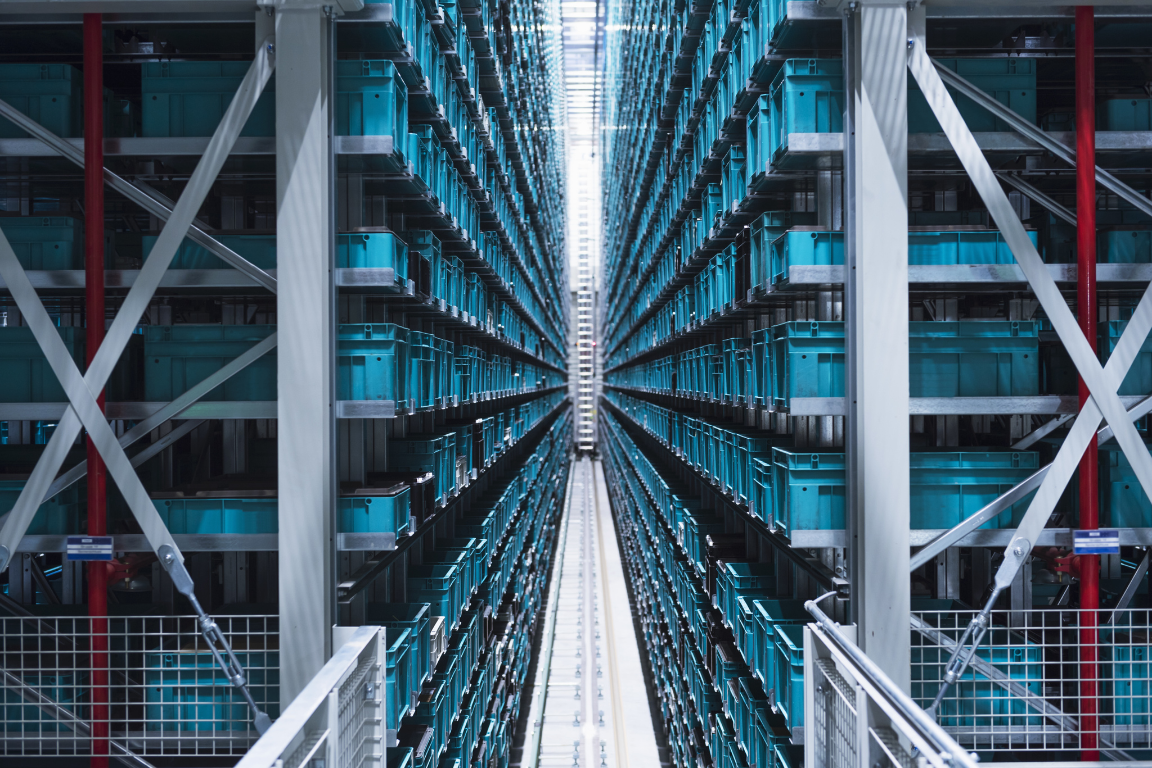


TRANSFORMATIONAL DATA WAREHOUSE FOCUS AREAS
Traditional Data Warehouse Optimization
Transform Status Quo
Operations & Events Data Warehouse
Run Business Better
Research & Discovery Data Warehouse
Change the Culture
Use Case Explosion across all three
Notes:
There are the three growing areas within the Data Warehouse Market that are compelling organizations to transform their infrastructure.
First is Data Warehouse Optimization:
This is about transforming the status quo. What we look for here .. are customers that have existing data warehouses or data marts .. that are underperforming, or facing expensive expansion .. to keep up with their existing solution.
Examples include Oracle, Teradata, and Netezza users that need to get back on track with their reports and meet SLAs.. CDP Data Warehouse Experience provides them with a flexible platform to perform their work.
Second is Operations and Events Data Warehousing:
This is about running your business better. These are NEW use cases focused on improving the overall business operations.
This is where we bring in new log data, IoT or internet of things data, and other new sources of data ,, and start to form a picture of where we can optimize the business.
For example, a major electric company realized that if they could get meter data every 15 seconds vs. every 15 minutes .. they could better manage peak demand spikes, and also charge for peaks .. that their old sample size simply missed.
Lastly there’s Research and Discovery Data Warehousing:
This is about fundamentally changing the way analytics is used in the enterprise, changing the culture. We are moving from known questions on known data .. to unknown questions on unknown data.
This use case is about exploring and analyzing data across the entire data lake, to include text data, unstructured data, together with the relational data, to tie in Machine Learning, and build models for future prediction.

Slide 6
3 EXPECTATIONS FROM A MODERN DATA WAREHOUSE
1
Must be integrated into a multi-function platform
2
Must provide agility with quick “time-to-value”
3
Must be deployable at massive scale across hybrid & multi cloud
Notes:
There are 3 expectations from a modern data warehouse are
1 - It must be integrated into a multi-function platform
2 - It must provide agility with quick time to value
3 - It must have flexible deployment choices .. at massive scale if required to meet SLAs .. and the ability to run across hybrid and multi-cloud whether its on prem or public clouds.
So what does Cloudera Data Warehouse Experience mean for you.. it allows you to quickly deploy existing or new use cases .. with the right data at the right time .. to tackle hard problems while meeting varying demands and SLAs. All with significant cost savings .. without extra effort on your part.

Slide 7
CUMBERSOME: TRADITIONAL DATA WAREHOUSE
Canned
Reports
EDW
ODS
ETL
4
2
3
1
Staging
Transformations
5
Master Schema
Dashboards
Months to Value
Data Marts
Structured Data Sources
(ERP, CRM, SCM)
Notes:
In a traditional data warehouse, Different stages of data transformation would typically take months to achieve goals. This is mainly is due to capacity constraints within existing on prem platform. Furthermore, it takes time for IT Platform teams who are normally overloaded .. to work on and provision the necessary infrastructure to support your new use cases.

Slide 8
ELEGANT: MODERN DATA WAREHOUSE
Canned
Reports
Storage and Catalogs
Ad Hoc
Ingest, Store All Data At Scale
[Directly on Object Stores]
Self-serve, On-demand
[VM or Container-based DW Service]
Virtual Data Warehouses
Orchestrated with Intelligent Workload Management
Dashboards
Minutes to Deployment
Advanced Analytics
Variety of data sources, types
Notes:
In this representation of the Modern Data Warehouse.. You can take away 3 main themes:
First is Compute is Planned and Isolated,
That it is optimized for your existing or new workloads.
And this optimized compute .. auto-scales to meet the your workload’s varying demands.
All of this happen in a simpler and more convenient self-service manner .. with minimal user intervention. And as compared to the traditional mode, CDP Data Warehouse experience provides much faster deployment for your use case.. Minutes vs Weeks or even Months using traditional methods.

Slide 9






TRADITIONAL ON PREMISE DATA WAREHOUSES
CAN’T KEEP UP WITH EVOLVING USER DEMANDS
Batch Resources
Onboarding Ephemeral Users
Data Engineers
Data Scientists
Evolving Workloads
Central IT
Concurrent User Population
Data Architects
Business Analysts
Notes:
Central IT is inundated with the diff needs from diff personas as Brad went through in his presentation.

Slide 10

Long provision times on
bare metal infrastructure
At a Major Bank, 25+ use cases on hold—getting to step 5 can take up to 30+ weeks per case on bare metal on-prem clusters.
LONG WAIT TIMES
3
4
Develop
SCENARIO I
Provision
2
5
Procurement
Deploy workflows
1
6
Planning
Deprovision
LOBs can’t wait

Slide 11




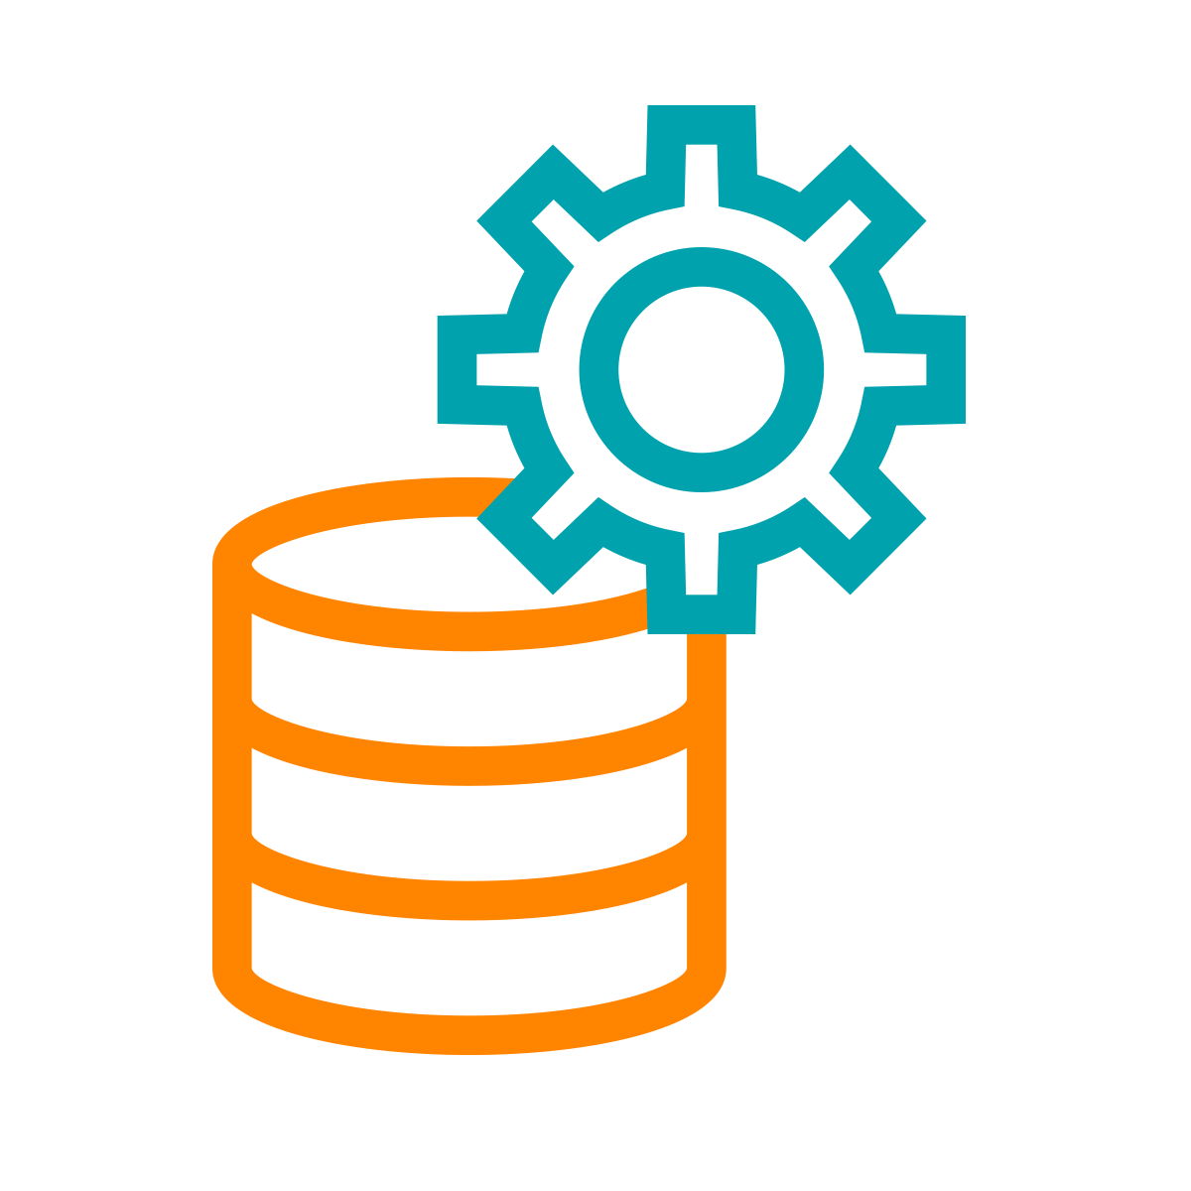

Data Flow
Data Engineering
Data Warehousing
Multi-tenant workloads share full capacity servers
At a Major Telco - primary environment is an expensive 140+ nodes monolithic cluster that is struggling to keep up with multiple workloads served by multiple compute clusters.
RESOURCE CONFLICTS
SCENARIO II
IT misses SLAs
Notes:
Operational setbacks; look bad

Slide 12
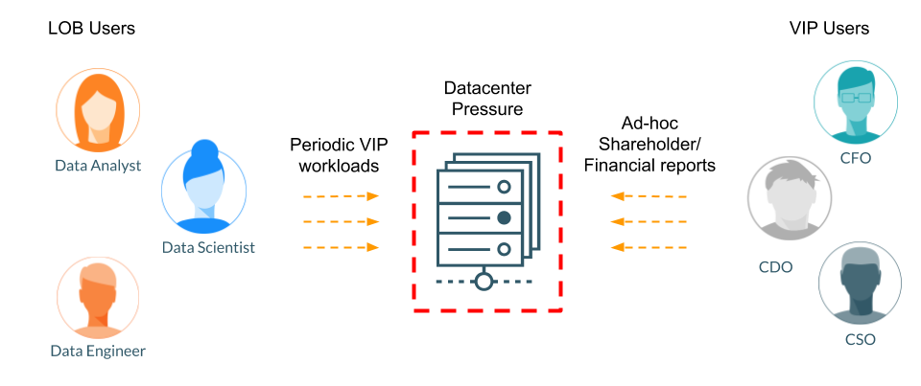
Data Center is running out AND capital budgets are maxed out
A Major Automotive company mandates moving workloads to the public cloud. Running their 3-hour / week warranty analysis reports (VIP workload) in a full-capacity Data Center is inefficient and expensive.
MEETING CLOUD MANDATES
SCENARIO III
Cloud mandates

Slide 13
CLOUD SOLUTIONS OVERCOME STRUGGLES
1
2
3
Traditional
COMPUTE
COMPUTE
STORAGE
STORAGE
PaaS User Experience
(Quick consumption, Pay-as-you-go billing)
Efficient Utilization
(Deprovision when idle,
Provision when needed, Isolate workloads)
Modern Architecture
(Separate Compute & Storage,
Agile Provisioning/Scaling)
Applies to public (AWS, Azure, GCP) and private (OpenShift, ECS) clouds

Slide 14
CLOUDERA DATA WAREHOUSE ON CLOUDERA DATA PLATFORM
Cloudburst - Autoscale, Suspend, Resume - Workload Isolation - Data & Metadata Caching
Bursting to Cloud: Migrating a Data Warehouse Workload from On-Premise to Cloud
Register Public Cloud (ex: AWS) with Cloudera Data Platform (CDP)
Use WorkloadXM to identify workloads and prepare "Cloudburst"
Copies on-premise data, metadata, security policies and data lineage to cloud (ex: AWS S3)
Sets up compute necessary to run the workload
estimation of 10 nodes on EC2
Automatic Resource Allocation: Autoscale, Auto-Suspend, Auto-Resume
Workload XM Estimates Cluster Size (Ex: 10 node cluster to start, expandable to limit of 50 nodes in blocks of 10)
No Idle Consumption - With no queries, wait until first query before auto-start of 10 node cluster: starts within minutes
As demand spikes - Cluster Grows (10 to 20, 30, 40 and 50)
As demand recedes - Cluster shrinks. Last query, Cluster Suspends (stops charges on CDP & Cloud (AWS))
Workload Isolation: Different Workloads, Different Engines, No Collision or Competition for Resources
Users Select Data from Database Catalog
Users Create New Workload (ex: Hive Data Warehouse)
Also capable of auto scale, suspend, resume
Different Users - Different Tasks (ex: Data Science with Spark, Data Engineer with Hive, BI Analyst with Impala - same AWS S3 store, multiple clusters each separately expanding/suspending as needed)
Data & Metadata Caching: Optimize Performance, Reduce Costs: Cache Data, Metadata, & Result Set
Using Data Analytic Studio (DAS) - Monitor Query results. First time execution takes longest (ex: 2-3 minutes)
Same query, second run significantly faster (Ex: 15 seconds)
Similar query - different aggregate, runs faster. Runs even with a suspended cluster, as result set is cached (zero cost query result)
Different Arguments, Same Data - runs faster using cached data, cached metadata, and cached result set together
Notes:
These are some of the important features of CDP Data Warehouse Experience
Cloudburst
Ability to autoscale, suspend and resume.
Workload Isolation to prevent noisy neighbor problem.
Data and Metadata caching for improve performance.

Slide 15
Getting Started & Hands-on
CDW product overview and lab
https://github.com/pwate/cdptestdrive/blob/main/CDP_Workshop_CDW.pdf
https://github.com/pwate/cdptestdrive

Slide 16
Cloudera Machine Learning
(CML)

Slide 17

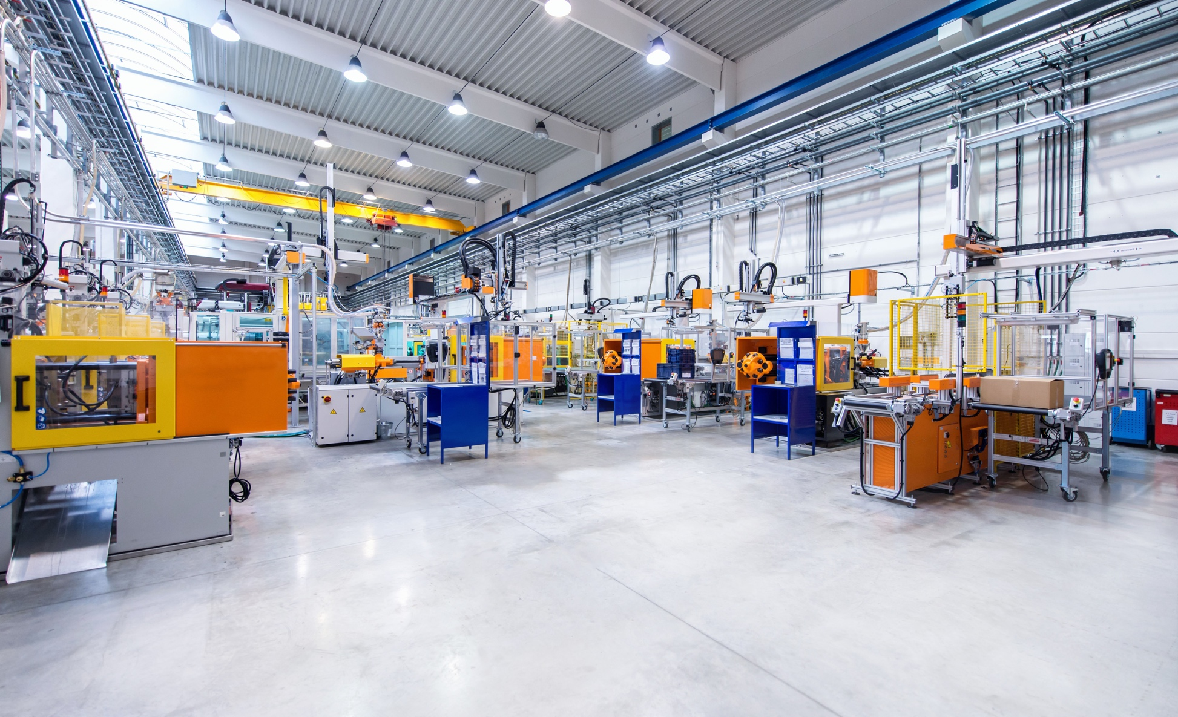

OUR GOAL: SCALABLE ENTERPRISE MACHINE LEARNING
Moving from exploration to production at factory scale
FROM THE LAB…
TO THE FACTORY...
TO THE EXPERIENCE

Slide 18
35%
Making it to production
Currently only 35% of organizations indicate that analytical models are fully deployed in production and are often challenged in the “last mile” of the complex and iterative ML workflow
* IDC’s Advanced and Predictive Analytics survey and interviews, n = 400, 2017 – 2019
Notes:
But it’s hard… trending towards major barriers to getting ML in production. Gartner calls it the “wall to production” - the challenges to getting ML capabilities embedded and maintained in a real business process once you’ve built a working model.
This IDC study says only 35% of organizations surveyed report getting machine learning capabilities into production - that means people are spending and data science teams are building these really cool things that never leave the walls of the lab..
IDC reference comes from this SAS PR: https://www.sas.com/en_us/news/press-releases/2019/october/model-ops-last-mile.html

Slide 19
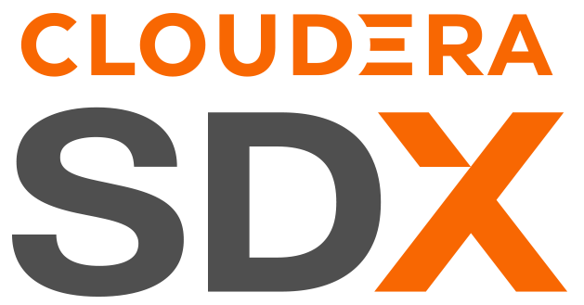
MACHINE LEARNING IN PRODUCTION
Business Inputs
Machine Learning Operations
Data Science
Model Training
Packaging
Deployment & Serving
Monitoring
Data Engineering
Closed Loop ML
Model Security
Model Governance
Model Catalog
Feature Store
Data Catalog
Notes:
Machine Learning isn’t a single activity - it’s an end to end workflow with many phases. It’s critical that customers look at the end to end capability for developing data pipelines for ML, the model development life cycle including model training, to the software development discipline of moving models to production and keeping them up and monitoring overall model health - including mathematical boundaries along with the technical performance.
Finally, getting models to production is only half the battle. You need capabilities that help you manage, govern, and discover models in addition to the data itself. Cloudera looks to provide SDX functionality for this with a focus on Models.

Slide 20
MACHINE LEARNING IN PRODUCTION IS MORE THAN JUST ML
Sensors/IoT Devices
MACHINE LEARNING
Predictive Services
DATA FLOW & STREAMING
DATA
ENGINEERING
DATA WAREHOUSE
BI Tools and SQL Editors
OPERATIONAL DATABASE
Data Products
DATA, METADATA, SECURITY, GOVERNANCE, WORKLOAD MANAGEMENT
Notes:
And why is it so hard from a Technology standpoint?
Developing and putting machine learning capabilities to work for the business requires more than machine learning tools and technologies - it requires end-to-end data and analytics pipelines:
Starting with the data source: via streaming or batch ingested into the pipeline
Then data engineering to clean and prep for machine learning analytics
Then data science tools to building and train models
Then you need more analytics services to embed that intelligence in the fabric of business, whether through:
Predictive services/APIs
BI Dashboards
Data Products/Apps
Or Intelligent edge devices
And you have to think about managing the data and its security and governance context throughout that lifecycle… remember what the HBR article said: “Silos are the enemy of AI-powered progress”!!....

Slide 21
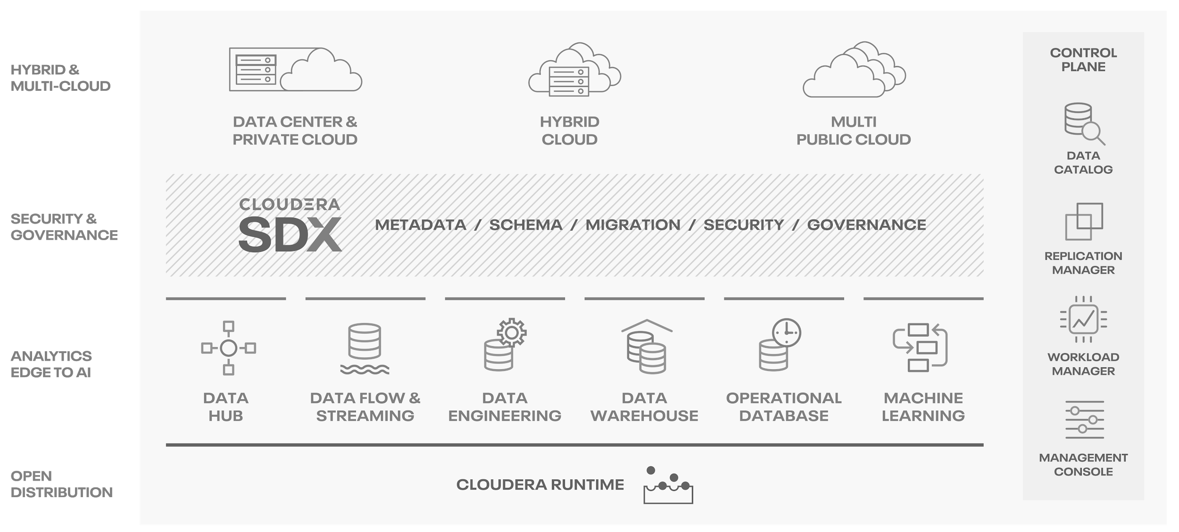
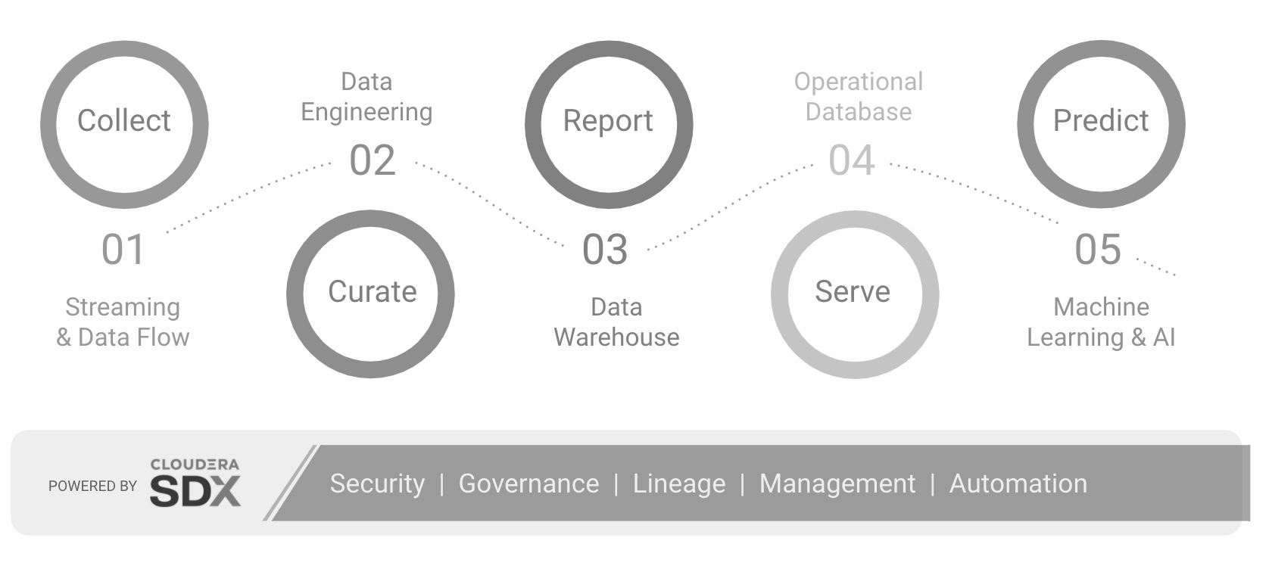
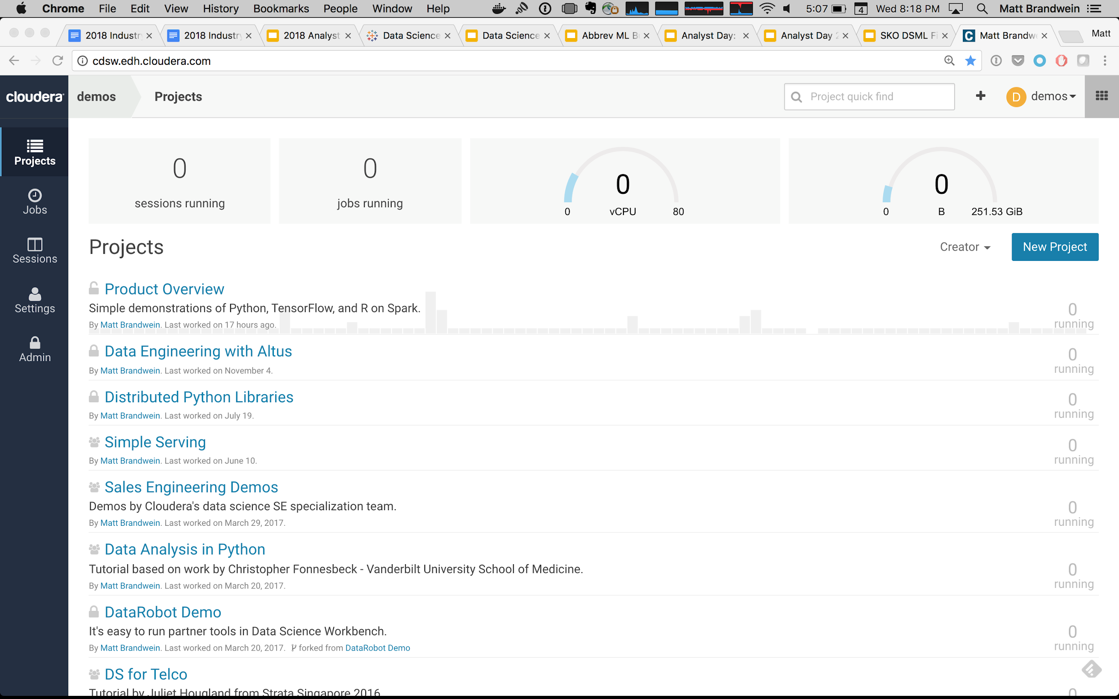

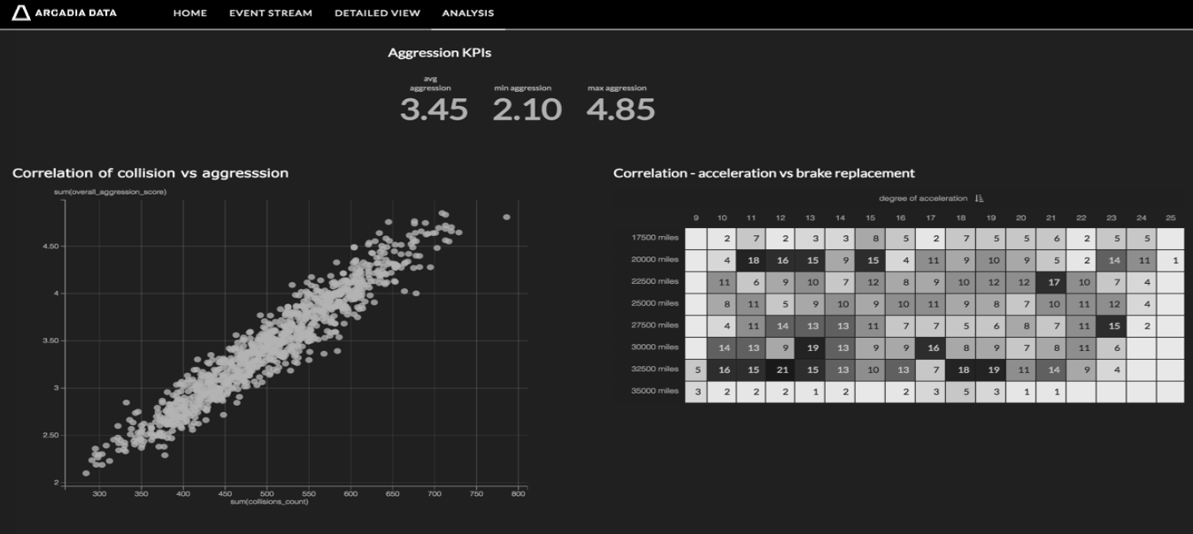


MACHINE LEARNING AT CLOUDERA
Innovation in the platform and analytics
Any Tier, All Data
Hybrid platform across multiple clouds and data centers
ML Lifecycle Tooling
Only offering with integrated experiences with SDX backed security and governance
Augmented Workflows
Collaborative and integrated BI & Augmentation from expert data scientists to data analysts

Slide 22

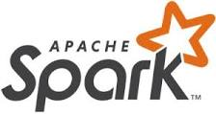





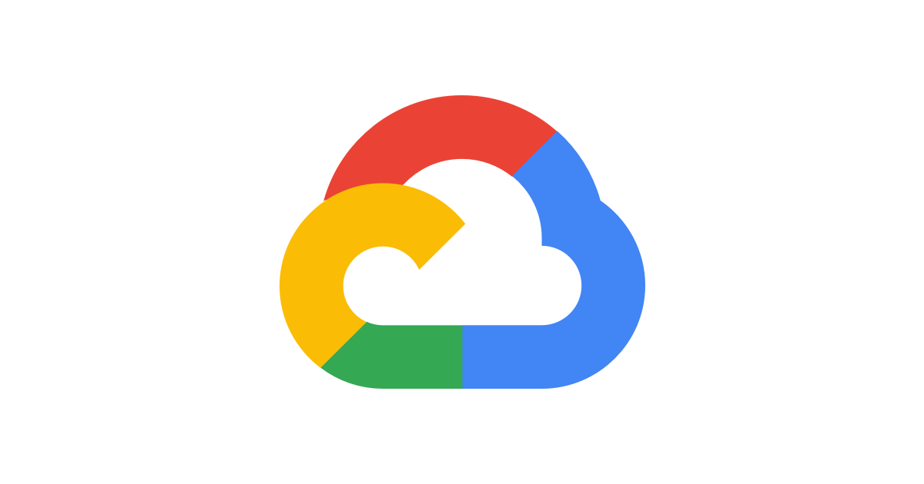
CML IS BUILT FOR THE CLOUD
Cloud-native enterprise machine learning as-a-service
CDP Management Console
END-TO-END DS/ML
FLEXIBLE DATA
ENGINEERING
ML Workspace
ML Workspace
Accelerate Data Science from research to production
Easy to use, self-service, on-demand, elastic spark for data engineering
ML Runtime
ML Runtime
...
ML Runtime
ML Runtime
...
SECURE & GOVERNED
KUBERNETES
& CONTAINERS
autoscaling resource groups
Self-service data & elastic compute with guardrails
Adoption as standard operating environment for flexibility and agility
Notes:
.. to cloud-native deployment on CDP - machine learning for the enterprise data cloud.
DE/ML from research to production
Same end-to-end workflows as CDSW
Pre-packaged ML runtime
Seamless scale-out experience
Rapid provisioning and elastic autoscaling
Automatic dependency management
Distributed CPU and GPU model training
Managed service on CDP
No (Spark) clusters to manage
Containerized multi-cloud and private cloud portability
Key Features & Benefits
ML Workspaces without waiting: Cloudera Machine Learning lets administrators deploy new machine learning workspaces for teams in a few clicks, giving data science teams access to the project environments and resources they need for end-to-end ML without waiting.
Democratized access to governed data: With Cloudera Machine Learning, administrators can easily replicate governed data sets across hybrid and multi-cloud environments to give data science teams self-service access to the business data they need while maintaining enterprise data security and governance controls.
Data science teams’ preferred, open tools: Beyond Python, R and Scala, modern data science teams need the latest open source tools and libraries for innovation and to collaborate while working in their preferred IDE. Cloudera Machine Learning gives practitioners the freedom to use their favorite tools while preserving security, efficiency and scalability without administrative overhead.
Elastic, auto-suspending resources including GPUs: Innovation can be unpredictable but should be unstoppable. Cloudera Machine Learning gives data science teams access to the scale-out, heterogeneous computing resources they need to get work done fast while maintaining adjustable guardrails that help IT easily manage and optimize infrastructure resources and costs.
Comprehensive, cohesive user experience: Machine learning can’t begin until data is ready, and it doesn’t end when a model is trained. ML for business requires data engineering, model training and experiment tracking, and deploying and managing models in production. Cloudera Machine Learning gives teams the tools for it all in one cohesive environment without switching or stitching workflows together multiple tools.
Portable and consistent: In a hybrid or even multi-cloud world, shouldn’t your ML platform be portable? Cloudera Machine Learning lets the business move data and infrastructure anywhere without creating disconnected silos and without changing the consistent user-experience that data science teams rely on for building robust
workflows and processes for end-to-end ML.

Slide 23
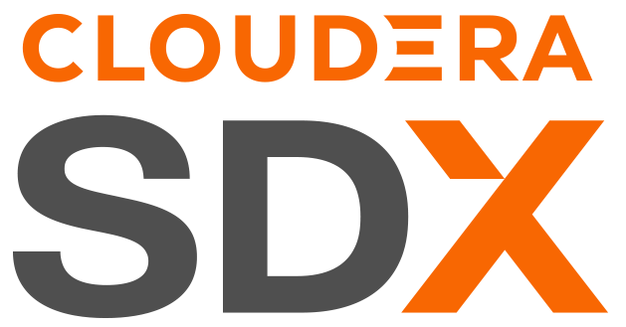
MLOps in Cloudera Machine Learning
Enabling Production ML At Scale
MODEL & PREDICTION MONITORING
UUID for each prediction
Analyze metrics granularly to the feature level
Ground truth to production environments
MODEL DEPLOYMENT &
HA SERVING
One-click deployment of models
Robust and HA model serving infrastructure
SHARED DATA EXPERIENCE FOR MODELS
Automatic model cataloging & lineage
Governed and secure production workflows

Slide 24
Getting Started & Hands-on
CML product overview and lab

Slide 25
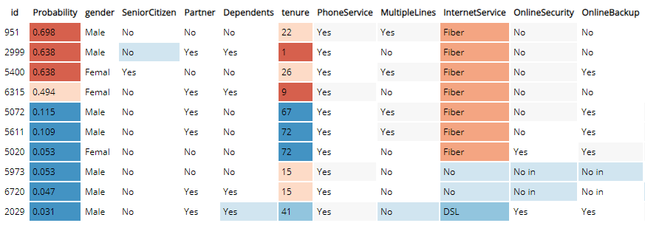
CML Project Overview
This project builds the telco churn with model interpretability project discussed in more detail this blog post. The initial idea and code comes from the FFL Interpretability report which is now freely available and you can read the full report here
The goal is to build a classifier model using Logistic Regression to predict the churn probability for a group of customers from a telecoms company. On top that, the model can then be interpreted using LIME. Both the Logistic Regression and LIME models are then deployed using CML's real-time model deployment capability and finally a basic flask based web application is deployed that will let you interact with the real-time model to see which factors in the data have the most influence on the churn probability.

Slide 26
CML Workshop Hands On
https://github.com/avijeetdash/cdptestdrive /blob/main/CML_Workshop.pdf
https://github.com/avijeetdash/cdptestdrive

Slide 27
Thank you!

